Slide 1
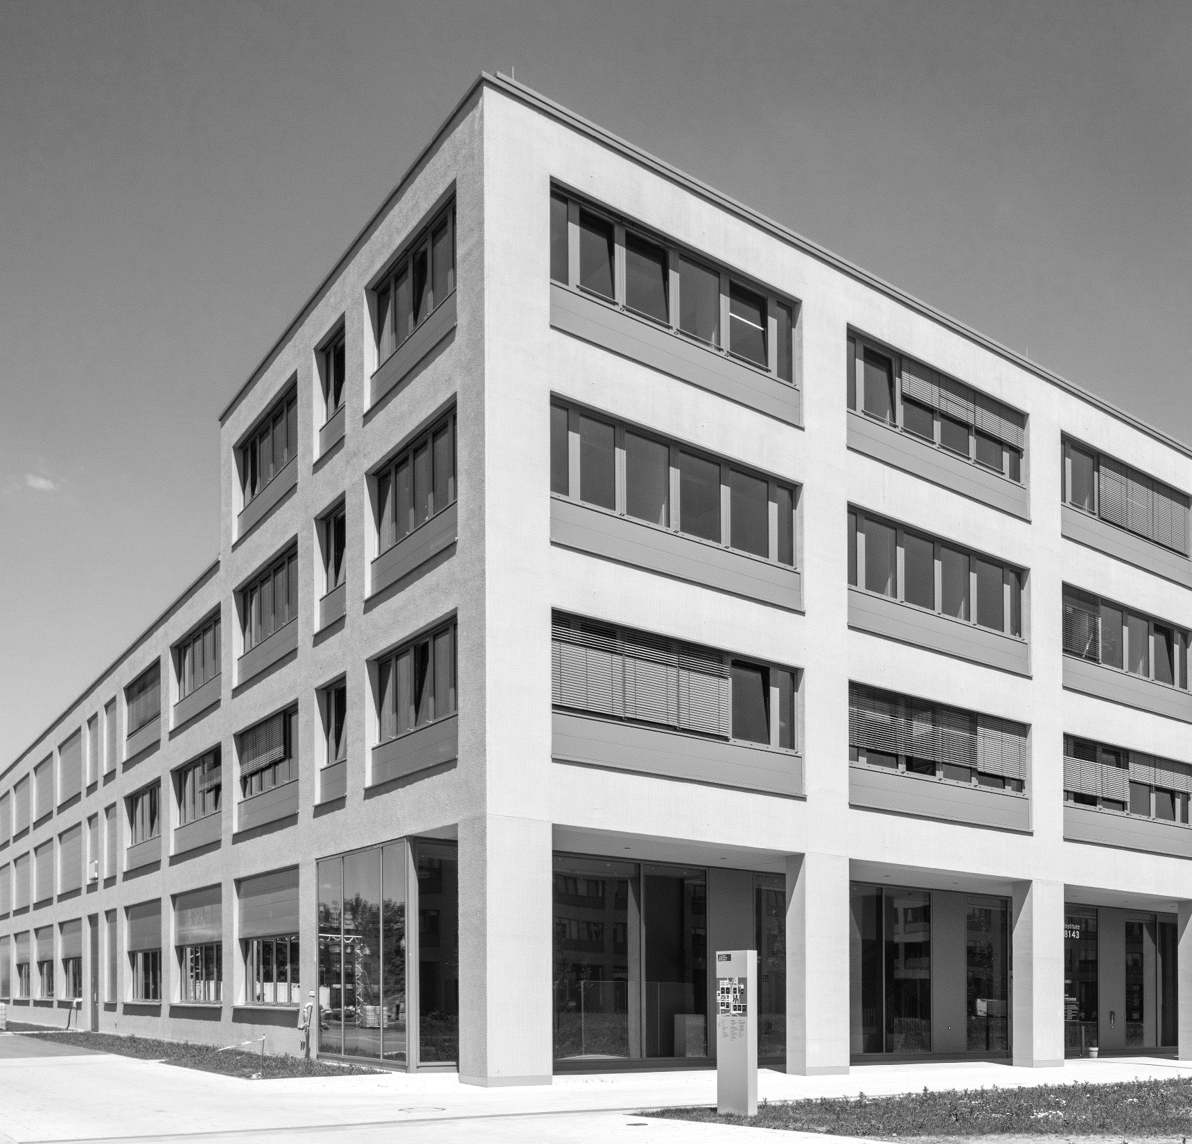
Calculation of geometric values for shape and load sensing from CAD models

Slide 2
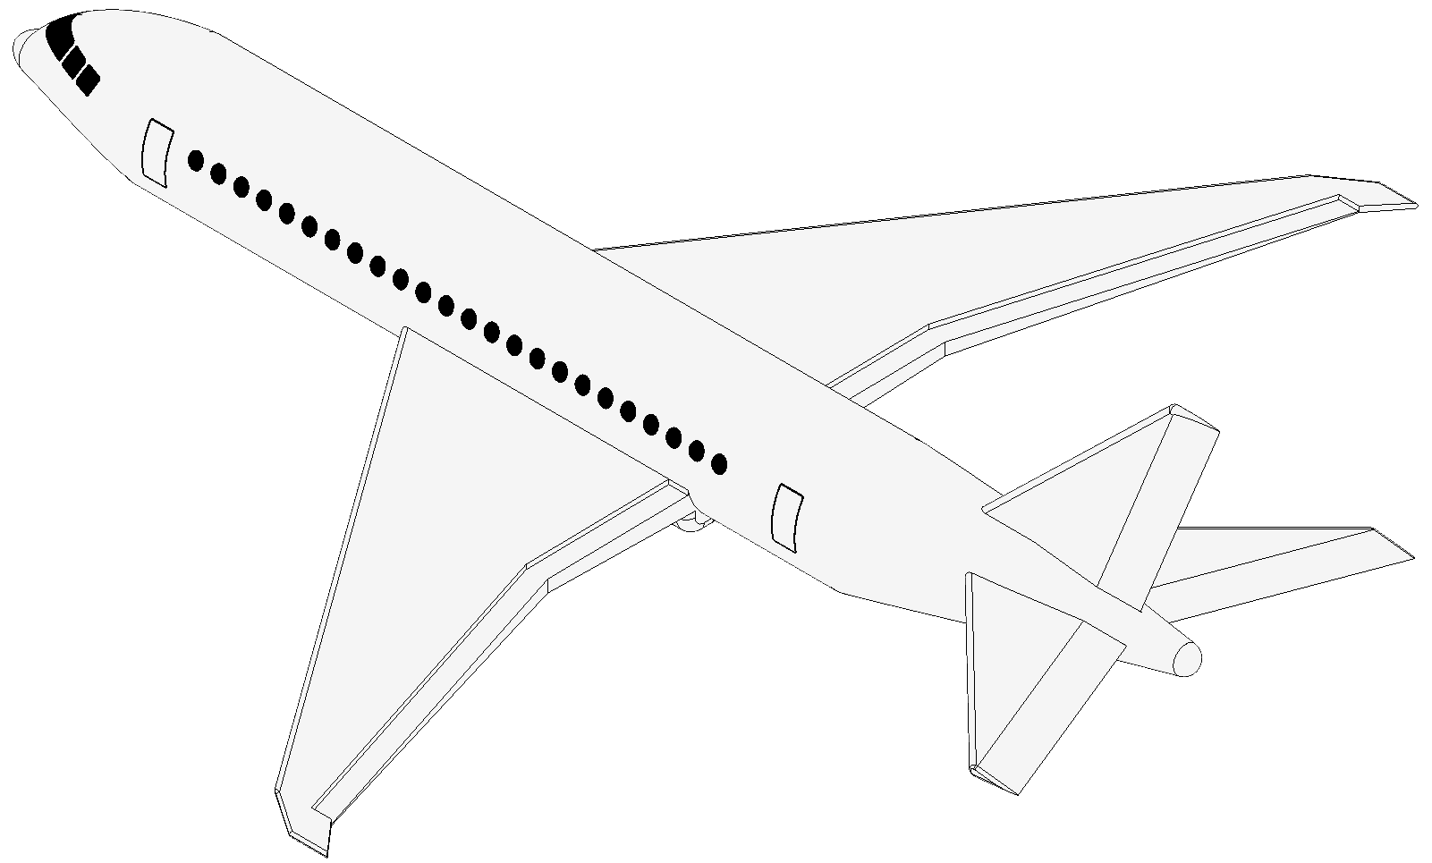
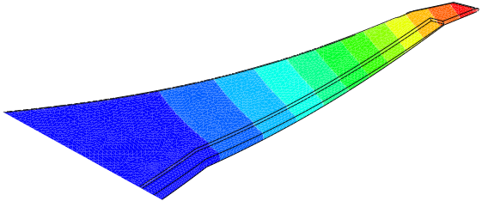
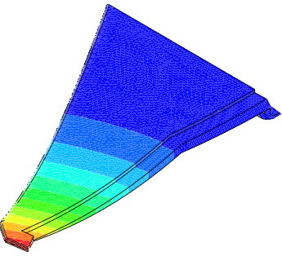
Motivation
Varying cross sections along the wing make it difficult to calculte the deformations
Source: IPeG, Sören Meyer zu Westerhausen
Deflection w [mm]
500,0
454,6
409,1
363,6
318,2
272,7
227,3
181,8
136,4
90,9
45,5
0,0

Slide 3

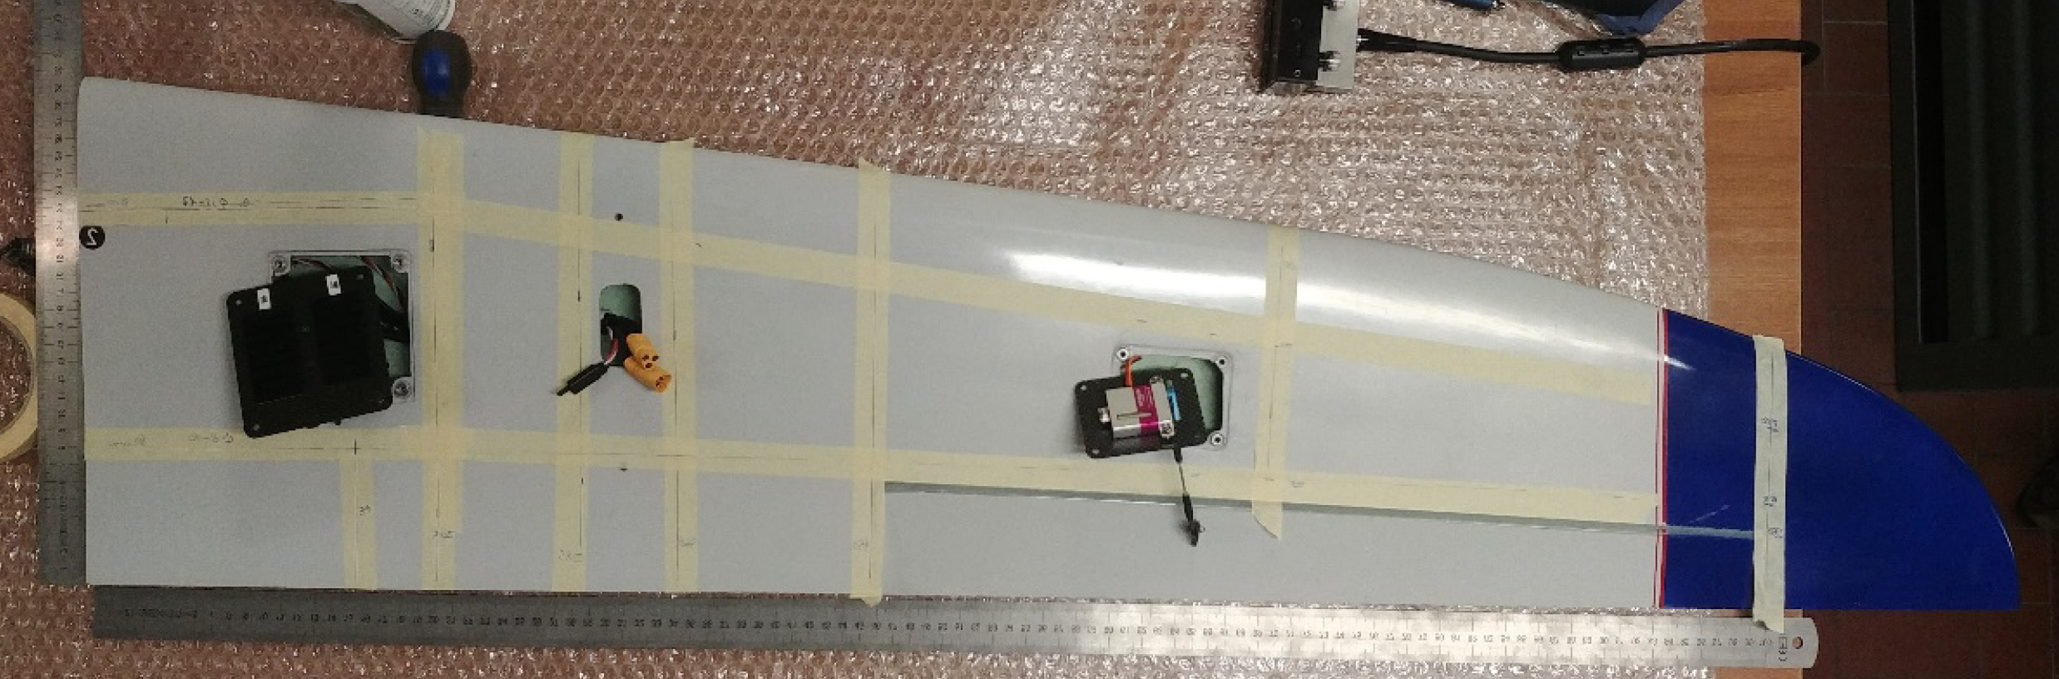
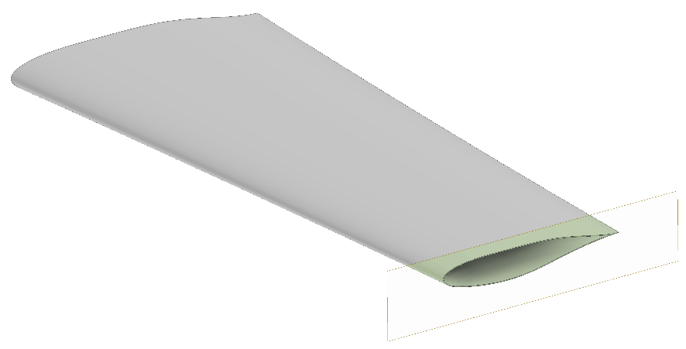
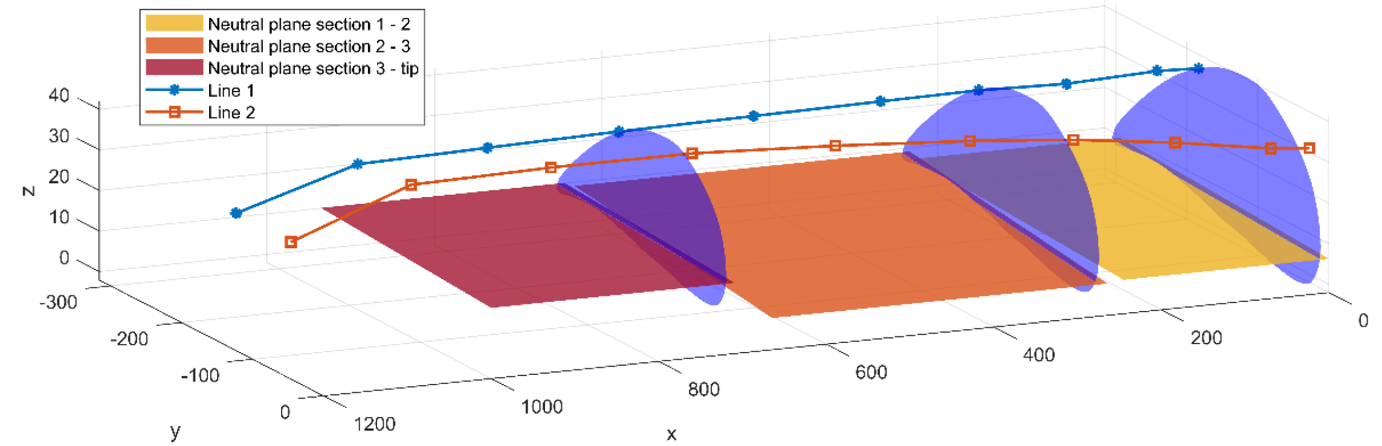
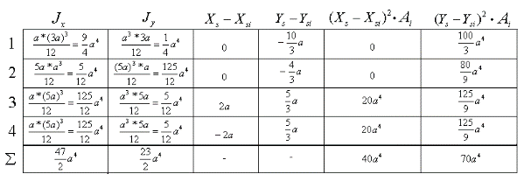
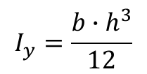
State of the art
Assumptions for geometric parameters
Calculation by Hand
Commercial Software
$$I_{y}=\frac{b∙h^{3}}{12}$$
Source:
Aerospace 2022, 9, 509.
https://doi.org/10.3390/aerospace9090509
Filippo Valoriani
Risk of unprecise results
High time effort needed
Not automated
Not open source (requires license)

Slide 4
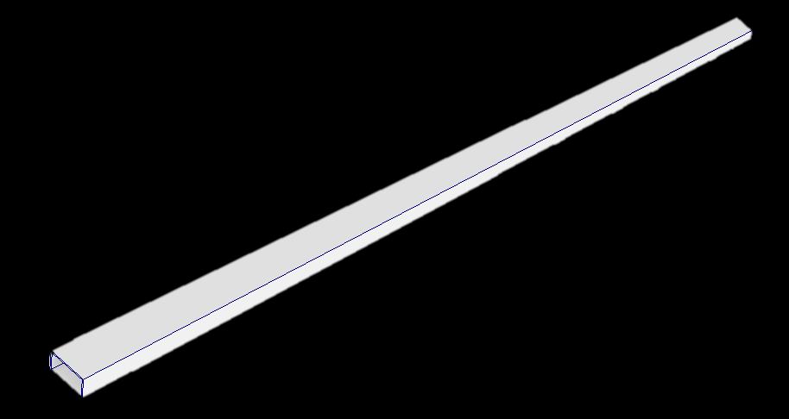
Demonstration part for the algorithm development and testing
Hollow rectangular bar
Linearly decreasing cross section
Simplified aircraft wing box

Slide 5
Developed Algorithm
Calculation of area
Reading the 3D model
Converting of geometry to points
Triangularization
Calculation of moments of inertia

Slide 6
Developed Algorithm

Slide 7
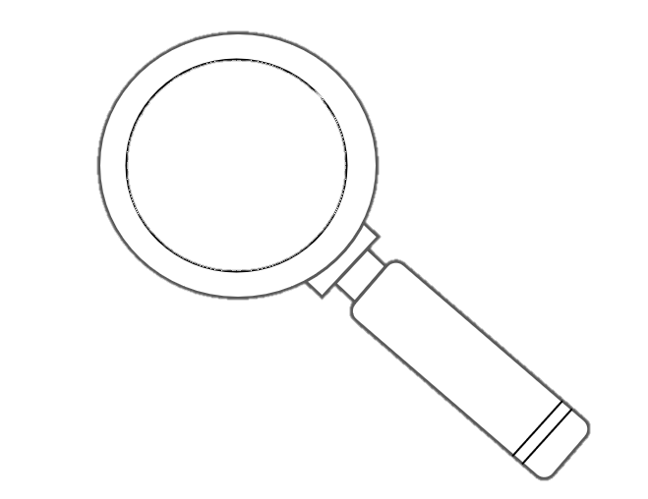
Developed Algorithm

Slide 8
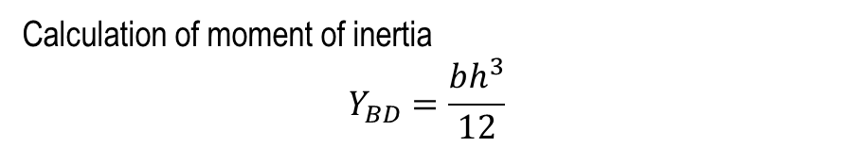
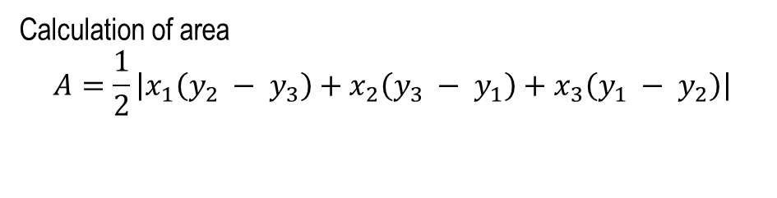
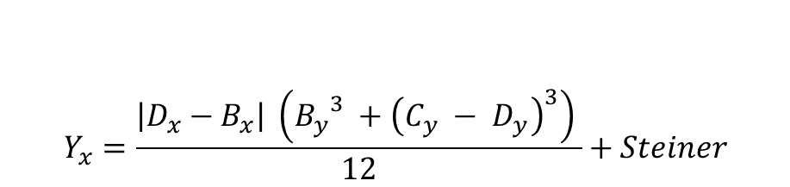
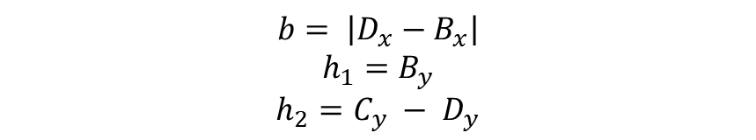
Developed Algorithm
Y
Calculation of area
$$A=\frac{1}{2}\left|x_{1}\left(y_{2} − y_{3}\right)+x_{2}\left(y_{3} − y_{1}\right)+x_{3}\left(y_{1} − y_{2}\right)\right|$$
C
Calculation of moment of inertia
$$Y_{BD}=\frac{bh^{3}}{12}$$
D
B
$$b= \left|D_{x}−B_{x}\right|$$
$$h_{1}=B_{y}$$
$$h_{2}=C_{y} − D_{y}$$
$$Y_{x}=\frac{\left|D_{x}−B_{x}\right| \left({B_{y}}^{3} +{\left(C_{y} − D_{y}\right)}^{3}\right) }{12}+Steiner$$
A
X

Slide 9
Analysis of the algorithm's performance
# points | Area (error) | Moment of inertia (error) | Time
100 | 1.5% | 0.9% | 464 ms
1000 | 0.05% | 0.06% | 1125 ms
10 000 | 0.003% | 0.09% | 2287 ms

Slide 10
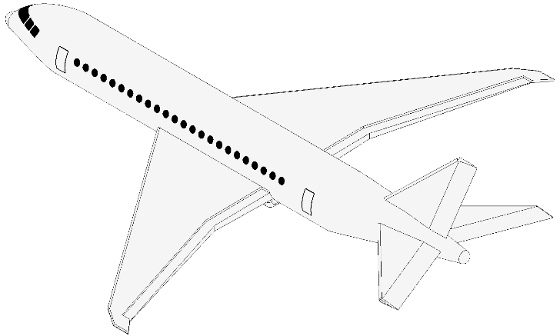
Conclusion and future work
Area +
Moment of inertia
Surprisingly fast
Very few input limitations
Pretty accurate
Never able to calculate completely correctly
Outlook
Optimizing sensor position
Ko’s shape sensing algorithm

Slide 11
Thank you for your attention!

Slide 12
Other solvable shapes

Slide 13
Motivation
Estimate the deformations from the measured loads using the shape sensing method.
To optimize the position of the sensors, cross sectional parameter necessary.
Variable distance to neutral fiber and therefore variable cross-sectional area

Slide 14
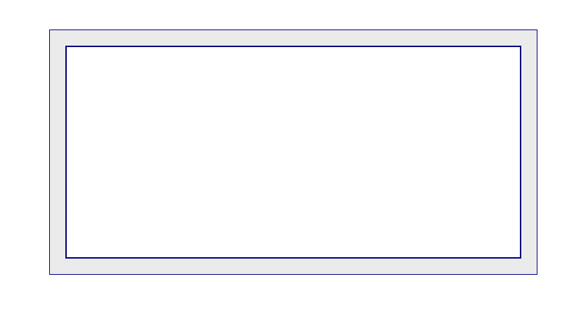
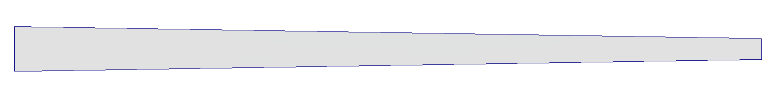
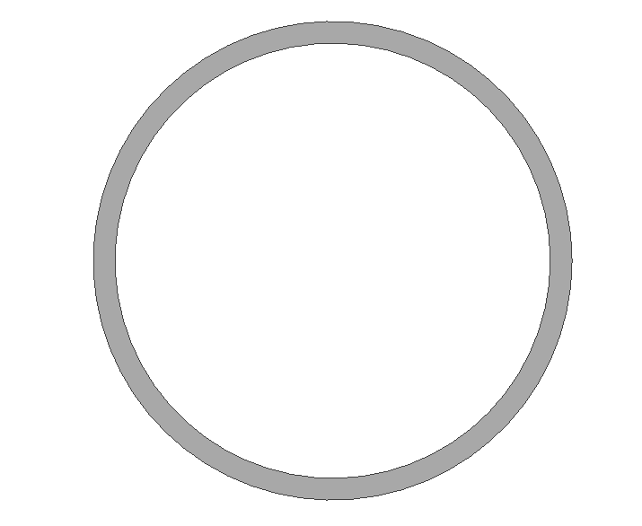
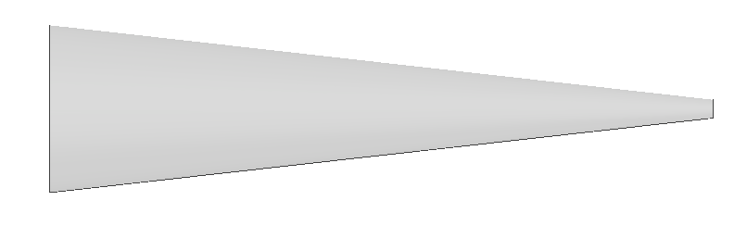
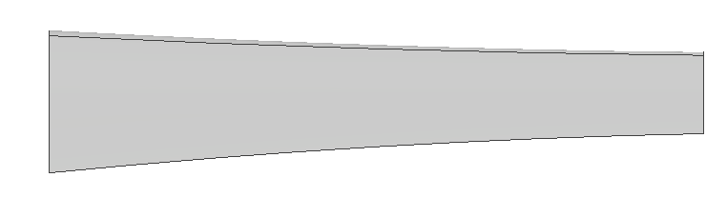
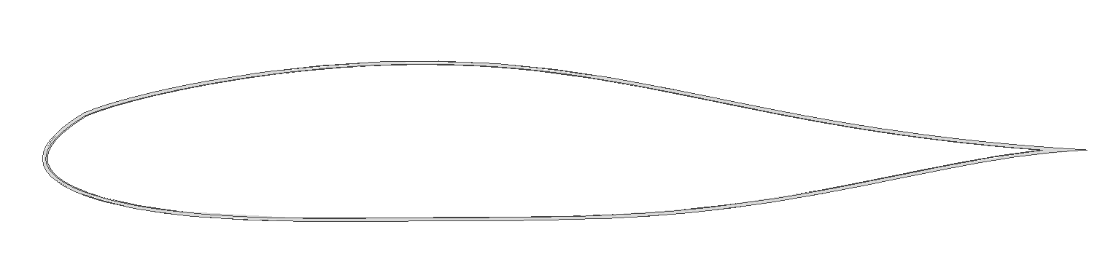
State of the art
Manual calculation – very precise, but slow and with a lot of limitations
CAD built in tool – fast at calculating but every calculation needs to be specified
My algorithm was designed to exactly fin the needs
Beams I can calculate:

Slide 15
Developed Algorithm

Slide 16
Analysis of the algorithm's performance

